Slide 1

Student-Athlete
Title IX Training

Slide 2


What is Title IX?
In simple terms, Title IX protects people from discrimination based on sex in education programs or activities that receive federal financial assistance.

Slide 3
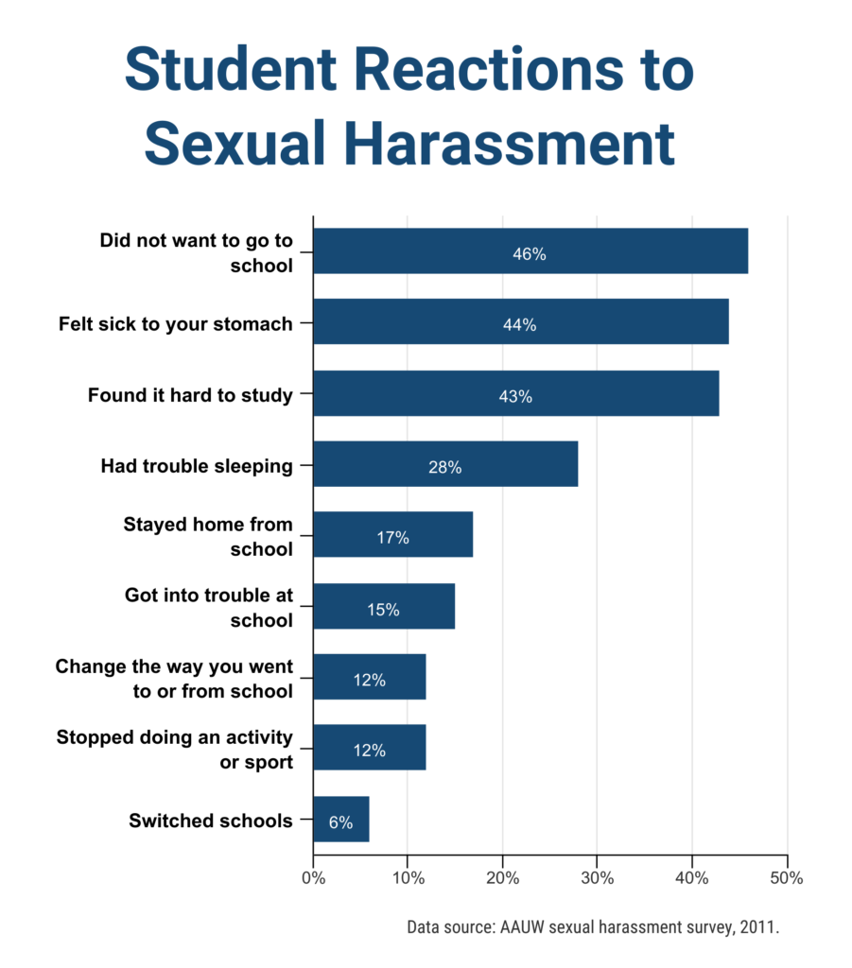
How is Sexual Harassment a Barrier to Educational Opportunities?
PTSD
• Anxiety/Depression
• Missed Classes
• Lower Grades
• Social Withdrawal
• Drug and Alcohol Abuse

Slide 4

What Does Title IX Cover?
Prohibited Conduct
Stalking
Sexual Harassment
Gender Discrimination
Dating Violence
Sexual Assault
Domestic Violence
Bullying or Intimidation
Notes:
When Title IX is mentioned, most people think about women and athletics. However, Title IX is about so much more; it also covers acts that can impact educational opportunities for all, including sexual harassment, sexual assault, and intimate partner violence (dating and domestic violence). Bullying and intimidation as well as stalking are also covered under this umbrella. Title IX also prohibits other forms of sex discrimination such as unequal pay and pregnancy.
University of the Southwest (USW) is committed to the achievement and maintenance of equal opportunity, inclusiveness, equitable treatment, and access to employment, education, and services for all individuals.
As part of that commitment, USW strictly prohibits the offenses of:
domestic violence (including relationship and roommate violence),
dating violence,
sexual assault,
sexual harassment, and
stalking.
The term sexual misconduct is an umbrella term used to encompass all such offenses.

Slide 5
Gender Discrimination
Acts of verbal, nonverbal, or physical aggression, intimidation, or hostility based on gender or gender-stereotyping, even if those acts do not involve conduct of a sexual nature
Denied access or parity in opportunity related to admissions, housing and facilities, courses and educational activities, career guidance and counseling activities, financial aid, or athletics based upon gender
Sexual Harassment
Unwelcome sexual advances, requests for sexual favors, and other physical or verbal conduct of a sexual nature
Actions of a sexual nature that create discomfort, embarrassment or fear in another person
Creation of a hostile work environment due to repeated harassment or a single, isolated incident, especially if physical in nature
Dating &/or Domestic Violence
Pattern of abusive behaviors used to exert power and control over a partner or roommate
Includes emotional, sexual, verbal or economic actions, or physical threats of violence
Acts may include any behaviors that intimidate, isolate, manipulate, humiliate, coerce, frighten, blame or hurt someone
Sexual Assault
Physical acts of rape, attempted rape, sexual touching, and/or sexual battery perpetrated against an individual without consent or who does not have the capacity to give knowing consent due to alcohol, drugs or disability
Sexual acts continued after a person has withdrawn his/her consent
Stalking
Pattern of unwanted conduct directed at another person that threatens or endangers the safety of another person
Threats or endangerment of a physical nature, mental health, or personal property
Threat or action that creates a reasonable fear in another person
Bullying or Intimidation
Any intentional electronic, written, verbal, or physical act or a series of acts directed at another student or group of students that is severe, persistent, or pervasive and has the intended effect of substantially interfering with a student’s education, creating a threatening environment, or disrupting the orderly operation of NGU
Intimidation includes any verbal, written, or electronic threats of violence or other threatening behavior directed toward another person or group that reasonably leads the person(s) to fear for his/her physical well-being

Slide 6
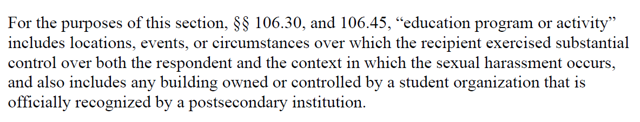
When does Title IX apply?
ALL educational programs and activities and conduct on any NGU owned or controlled property
Examples: classrooms, dorms, campus
BUT also, internships, field trips, club/team trips, etc.

Slide 7
Student-Athletes and Title IX
Why do student-athletes receive “extra” Title IX training?
Compliance with NCAA regulations
Student athletes played a role in about 33% of sexual violence on campuses
Student-athletes compose a significant and visible portion of the undergraduate population at colleges and universities across the country.
  Risk factors increase the likelihood of sexual misconduct from athletes.
  Athletes are often targeted due to celebrity-like status on campus

Slide 8
NCAA Student-Athlete Education Requirements
Healthy Relationships
Consent
Sexual violence prevalence
Harassment
Hazing & bullying
Stalking
Discrimination
The role of alcohol and drug use in SV

Slide 11
Consent is Ongoing
Consent is
permission for something to happen or agreement to do something.

Slide 12
Sexual Violence Prevalence
Risk factors that increase the likelihood that student-athletes will commit acts of sexual misconduct:
Rewarded aggressiveness
Celebrity status and entitlement
Bonding (male or female)
Sexualization and subordination of the opposite sex (locker room language)
Isolation from non-athletic peers.

Slide 13
Harassment, Bullying & Discrimination
Communication skills are needed to develop language that is not:
  Misogynistic
  Homophobic
  Demeaning
  Marginalizing
  Hostile
  Negative
  Don’t tolerate bullying, demeaning or discriminating talk

Slide 15
Inebriation and Consent
A person who is drunk or in any way incapacitated cannot give consent to a sexual act.
Even one drink is enough to qualify as incapacitated.
Friends/teammates don’t let their drunk/high friends/teammates make stupid mistakes that can have long-lasting consequences.

Slide 16
How do YOU prevent sexual harassment/violence?
Be a role model.
Don’t stand by and allow bad behavior.
Practice the buddy system in “risky” situations

Slide 17
Stand-up not by!
Notice the event
Interpret it as a problem
If not you, then who?

Slide 18
Upstander Intervention
Know how to help
Make sure it is safe for you to do so!
Assess your surroundings
If the situation is dangerous call for help
Take Action
Delay -Don’t leave.
Be that awkward third wheel.
If you remain at the scene, it’s less likely the perpetrator is going to do anything.

Slide 19
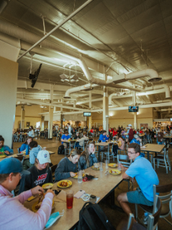
What can you do?
Challenge others who are exhibiting abusive tendencies
Be a leader not a follower
Lead by example!
Pull teammates aside privately.
Shut it down immediately!
Engage your team captains or coaches.
If you get called out. Own it. Take accountability.

Slide 20
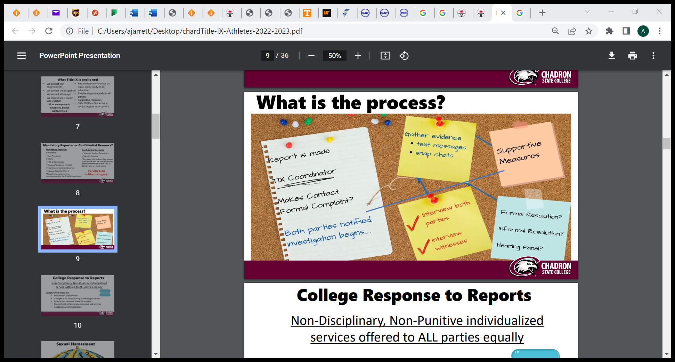
What is the process?
Report made
Title IX Coordinator makes contact
Is this a formal complaint?
Both parties notified, investigation begins.
  Fact finding
  Interviews
  Supportive measures
Formal resolution? Informal resolution? Hearing panel?
Possible sanctions issued.

Slide 21


Counseling Staff
Sara Black, MA, LPC
Counselor and Coordinator of Education and Outreach
Office Location: NGU Clinic
Office Phone: 864.977.2094
Email: sara.black@ngu.edu
Office Hours
Monday – Thursday
8:30 a.m. – 5 p.m.
Friday
8:30 a.m. – 12 p.m.
Steve Bielby, THM, LPC
Counselor and Coordinator of Clinical Counseling
Office Location: NGU Clinic
Office Phone: 864.663.0249
Email: sbielby@ngu.edu
Office Hours
Monday – Thursday
8:30 a.m. – 5 p.m.
Friday
8:30 a.m. – 12 p.m.

Slide 22
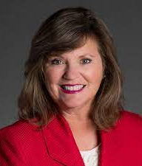
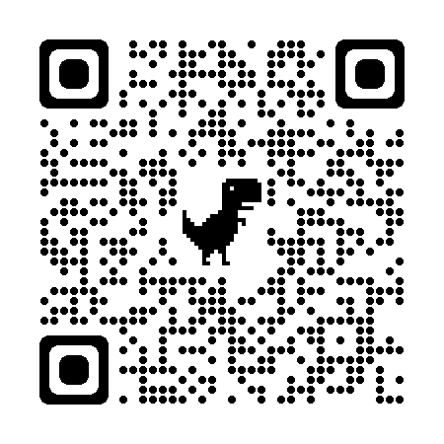
Title IX Coordinator, Tracy Kramer, PhD
Associate Dean, Graduate Business
Professor
Tim Brashier Campus, Room 231
864-977-7256
Online complaint form: see https://www.ngu.edu/titleix.php
By Mail: North Greenville University,
ATTN: Title IX Coordinator,
405 Lancaster Ave, Greer, SC 29650
In person or by email:
Dr. Jill Rayburn, jill.Rayburn@ngu.edu, General Counsel
Michelle Sabou, michelle.sabou@ngu.edu, Director of Personnel Services 64 Blackwell Road. phone: 864-977-7200
Dr. Jared Thomas, jared.thomas@ngu.edu, VP for Campus Ministries & Student Engagement, Tingle Student Life Center, First Floor, phone: 864-663-0148

